Slide 1

DriverPass
System Analysis
Thoura Chris Ouk

Slide 2

System Requirements
One functional requirement would be that the system must allow customers to make reservations with secretaries on the phone or in-office visits,.
User account management: The system must enable administrators to manage user accounts, including resetting passwords and blocking access for employees, and allow customers to create accounts and reset their own forgotten passwords.
One non-functional requirement would be Maintainability. The system’s structure should allow for future modifications and updates, particularly for adding or removing modules, even if it requires developer intervention.
Another non-functional requirement would be the reliability of the system. The system must reliably process reservations, track data, and maintain account integrity.
Notes:
In our system requirements here, I tried to make it pretty simple. The customer reservation system explains it all. The whole point of the DriverPass system is have customers make appointments online or on a mobile app to schedule their appointments. In addition to the in person visit and phone calls appointments. This feature addresses the need for accessibility and flexibility for customers.
The user account management would also be a major feature for the online DriverPass system. We are trying to make an online system here, so the whole purpose of this requirement is a big part of giving the customer something to do online. The system must enable administrators to also manage user accounts effectively, This includes things such as resetting passwords, blocking access for employees and allowing the customers to create accounts and reset their own forgotten passwords.
One non-functional requirement I pick is maintainability. I’m not too sure how maintaining the app would be too beneficial. I guess it is in a way, but it shouldn’t be too important. The system itself will allow for future modifications and updates.
Another non-functional requirement would be the reliability of the system. One would have to assume that the system would already be reliable, because there is really no point to having the system in the first place if it is not reliable. It defeats the purpose of it.

Slide 3
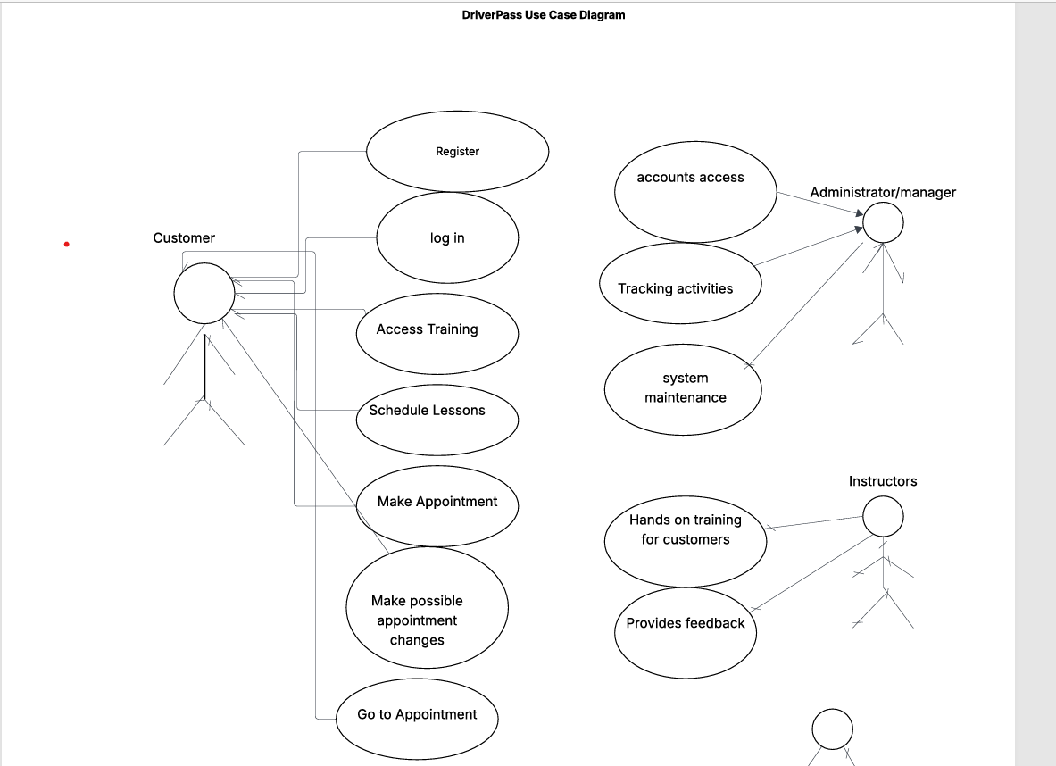
Use Case Diagram
Notes:
This is the simple Use Case Diagram that I created. It is design to be simple and straight forward. It just explains the role of the customer, administrator/manager and instructors(drivers). It doesn’t get into too much detail, but it gets the job done and is an easy to understand diagram.

Slide 4
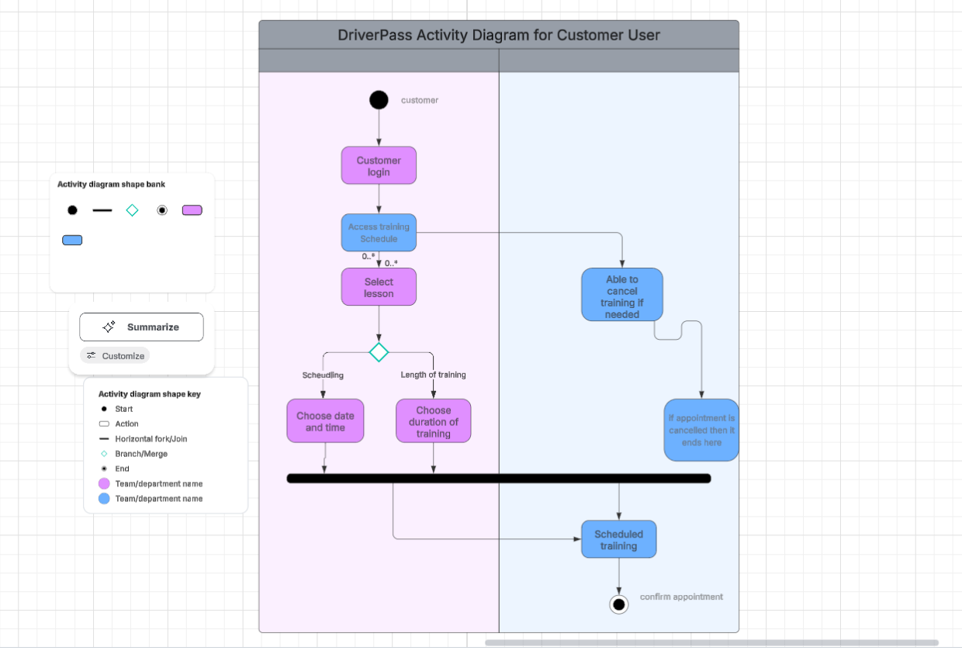
Activity
Diagram
Notes:
This is a very simple activity diagram for the user customer. It starts from the top left to the bottom right. The bold, black dots are indicators of the starting and ending point. The diagram shows the customer login, then the customer will be able to access the training schedule. After the training schedule, the customer will have two choices, Option one would be to select lesson and option two would be to be able to cancel the training if need be. If the customer chooses to cancel the training, then the training will go to the next step from there and the whole process ends. However, if the customer choose the first option, then they would continue to scheduling with the date and time or choose the duration of the training. Either one can come first and after the customer picks one, they will pick the other next and after that, the customer will schedule the training. That is the basic rundown of the user customer activity diagram.

Slide 5
Security
User Activity Tracking/Auditing
No customer self-service password reset
The system can use a Cloud-based system to run off the web. This provides more security
Secure handling of sensitive customer data
Notes:
We have designed the system security with security as a top priority. We focused on three main areas, data protection, handling of sensitive customer information and thinking about using a cloud-based system to run off the web for more data security. Although not too much of a concerned, because our IT department can handle it, we would also like to implement a system for where our customers would be able to have a self-service password reset ability.
For data protection, our system can have a system in place that can scramble the data like a secret code, so that even if someone managed to steal the information, they still wouldn’t be able to read and decipher it.
As for the user activity tracking/auditing, we can have some kind of account protection in place. To protect our customer’s account from being taken over, we can use a careful, secure process to verify our customer’s identity. This is why we avoided the customers being able to reset their own password when locked out.
Also, instead of running the system on our own computers, we can host it with a specialized, top of the notch security company. A company that is based off of a cloud. We would have a big team with a lot of knowledge and the best tools dedicated 24/7 to protecting the system from attacks and keeping it safe and running smoothly.

Slide 6
System Limitations
No easy customization
Not much communication between customers and instructors
Provide only basic scheduling
No advanced Instructor tools
Notes:
The system is of course not flawless, but we try to make it flawless as possible. Some limitations with our system would be not having easy customization for our customers. Meaning, it’s a simple, straight forward system that allows our customers to schedule and make appointments to their drive training. Nothing more to do or customize on the application. Our customers will not be able to have our customers adapt or personalize its settings or features to suit individual needs. This makes its flexibility a little less useful. Our system may not be able to provide much communication between the driver and our customers. It would be great if the application can provide a feature that will allow our customers to speak with their driver/instructors more.
The system also has a limitation in that it is only a system that allows basic scheduling. Scheduling for the day, time, and duration of their drive training.
The limitation of no advanced instructor tools would mean that the system does not offer specialized functionalities designed to enhance an instructor’s teaching capabilities or tasks. This may mean a lack of certain features in the system. Features such as lesson planning, automated feedback mechanisms, performance tracking and analysis and advanced communication features.

